Slide 1

Title: Machine Learning for Ti: To predict its thermal expansion coefficient
Yellanki Nagaraju(22EEB0A06)
Somu kavyasri (22BTB0A34)
Department of Mechanical Engineering
Machine Learning for materials informatics (MLMI)

Slide 2
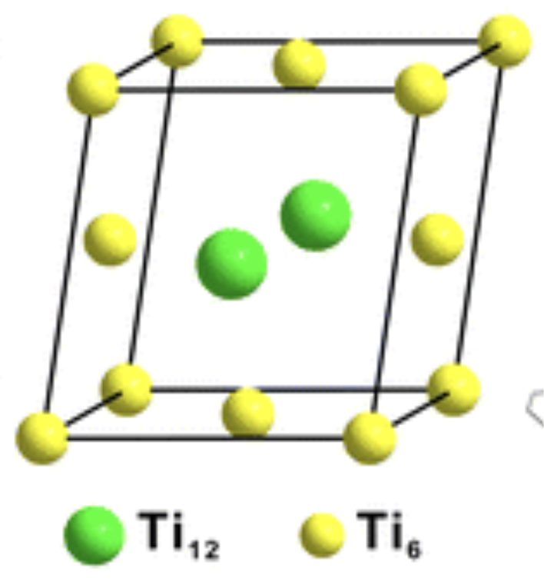
Titanium (Ti)
Basic Information:
Symbol: Ti Atomic Number: 22 Crystal Structure: Hexagonal Close-Packed (HCP, α-phase)
Lightweight and Strong Metal: High strength-to-weight ratio, density ≈ 4.5 g/cm³
Abundant element, found mainly in minerals like ilmenite (FeTiO₃) and rutile (TiO₂).
Physical and Mechanical Properties:
High tensile strength and low density (about 60% the weight of steel).
Outstanding corrosion resistance (especially in seawater and chlorine environments).
Good biocompatibility, suitable for medical implants.
Excellent performance at high temperatures (used up to 600°C).
2
Notes:
Why you studying this materials

Slide 3
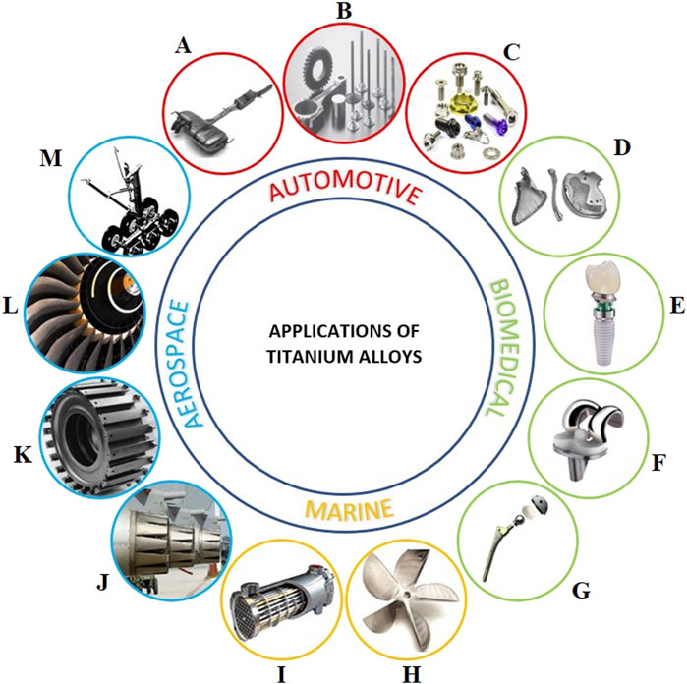
Titanium (Ti)
Automotive and Aerospace Industries:
Used in aircraft engines, frames, jet turbines, and aerospace fasteners due to its high strength-to-weight ratio.
Applied in automobile connecting rods, valves, and exhaust systems for weight reduction and durability.
Electronics and Consumer Products:
Utilized in laptop frames, sporting goods, and luxury watches for its strength, corrosion resistance, and sleek appearance.
Thin films of titanium are used in electronic circuits and resistors.
Energy and Environmental Fields:
Used in heat exchangers, desalination plants, and chemical processing equipment due to its corrosion resistance.
Catalysts in chemical reactions and anodes in electrolysis and batteries.
Potential material for hydrogen storage and fuel cell components.
3
Notes:
Why you studying this materials

Slide 4
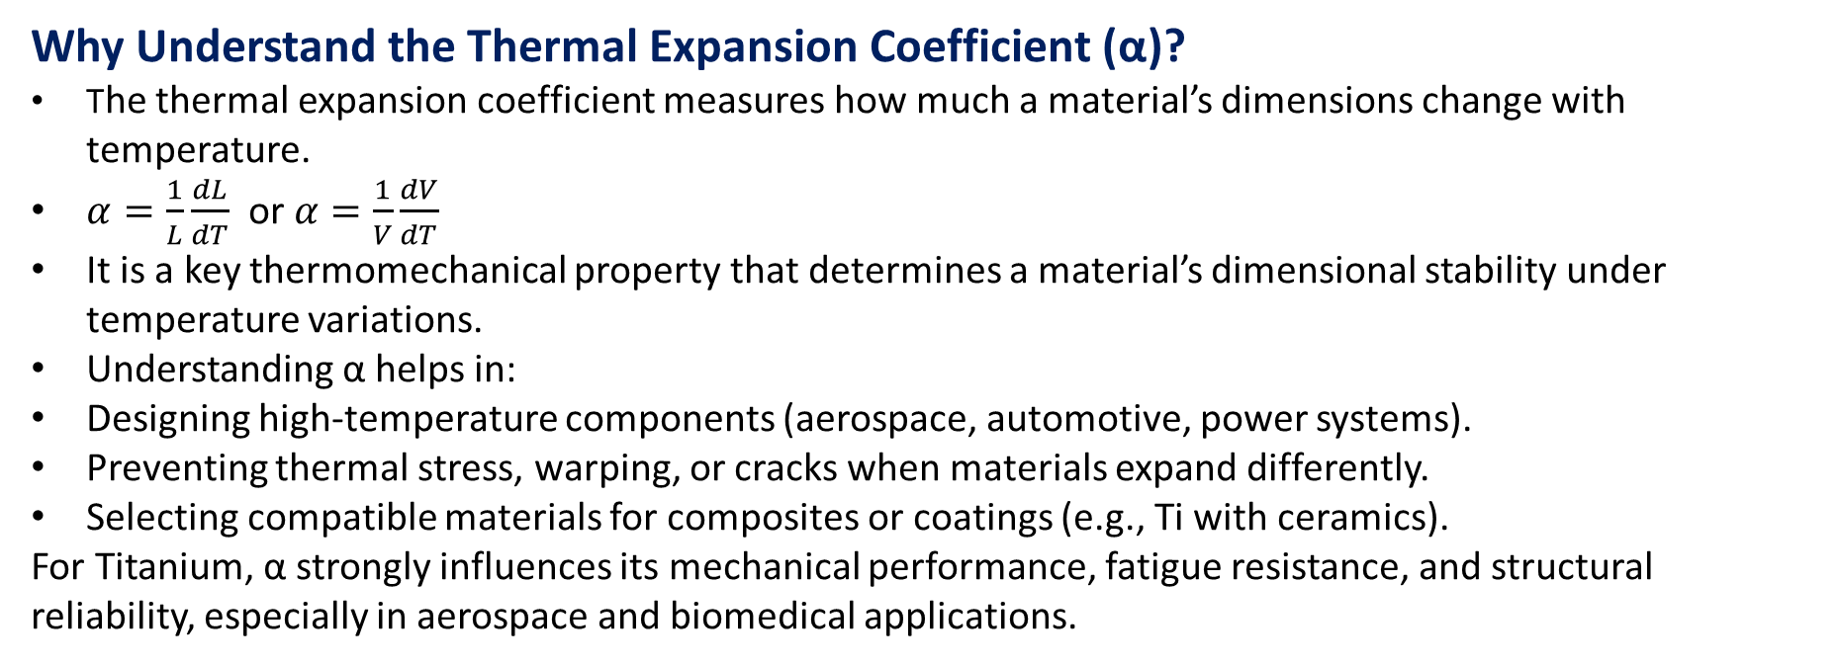
Objective
To investigate and predict the thermal expansion behaviour of Titanium (Ti) using Molecular Dynamics (MD) simulations and Machine Learning (ML).
The goal is to use ML models trained on MD data to rapidly estimate thermal expansion coefficients without performing new simulations for every condition.
Why Understand the Thermal Expansion Coefficient (α)?
The thermal expansion coefficient measures how much a material’s dimensions change with temperature.
$α=\frac{1}{L}\frac{dL}{dT} \text{or} α=\frac{1}{V}\frac{dV}{dT}$
It is a key thermomechanical property that determines a material’s dimensional stability under temperature variations.
Understanding α helps in:
  Designing high-temperature components (aerospace, automotive, power systems).
  Preventing thermal stress, warping, or cracks when materials expand differently.
  Selecting compatible materials for composites or coatings (e.g., Ti with ceramics).
For Titanium, α strongly influences its mechanical performance, fatigue resistance, and structural reliability, especially in aerospace and biomedical applications.
4

Slide 5
Why Molecular Dynamics (MD)?
Captures atomic-level behavior of materials under varying temperature and pressure.
Provides accurate thermodynamic properties — energy, pressure, and volume — from first-principles or empirical potentials.
Helps in understanding microscopic origins of macroscopic phenomena (like expansion).
Why Machine Learning (ML)?
Learns patterns and relationships between MD-derived features (Temp, Energy, Volume, etc.) and material properties.
Enables instant prediction of target properties (e.g., thermal expansion) for new conditions.
Reduces the need to re-run costly MD simulations.
But MD is computationally expensive and time-consuming for large temperature ranges or big systems.
Aspect | MD | ML
Accuracy | High (atomic-level) | High (if trained well)
Speed | Very slow for each new temperature | Extremely fast
Cost | Computationally expensive | Negligible after training
Purpose | Generate ground-truth data | Generalize and predict
5

Slide 6
Data generation using MD
Start Simulation Setup
6. Run Production Simulation
Record properties every 1000 steps
2. Define Parameters
Temperature range: 300 K → MP
Timestep = 1 fs
7. Extract Output Data
Pressure (bar)
Kinetic, Potential, Total Energy (eV)
Volume (Å³)
Temperature (K)
3. Create Atomic Structure
Define FCC lattice (Ti, a = 4.05 Å)
Create simulation box and atoms
8. Save Data as CSV Files
One file per temperature
Stored in output_data/ folder
4. Assign Potential
Use EAM potential
5. Initialize Velocity and Run NPT
Equilibration
Set temperature for each step
Allow system to reach equilibrium
9. End — Dataset Ready for ML Model Training
Use extracted properties to calculate thermal expansion coefficient (α)
Train ML model to predict α for new materials/conditions
6

Slide 7
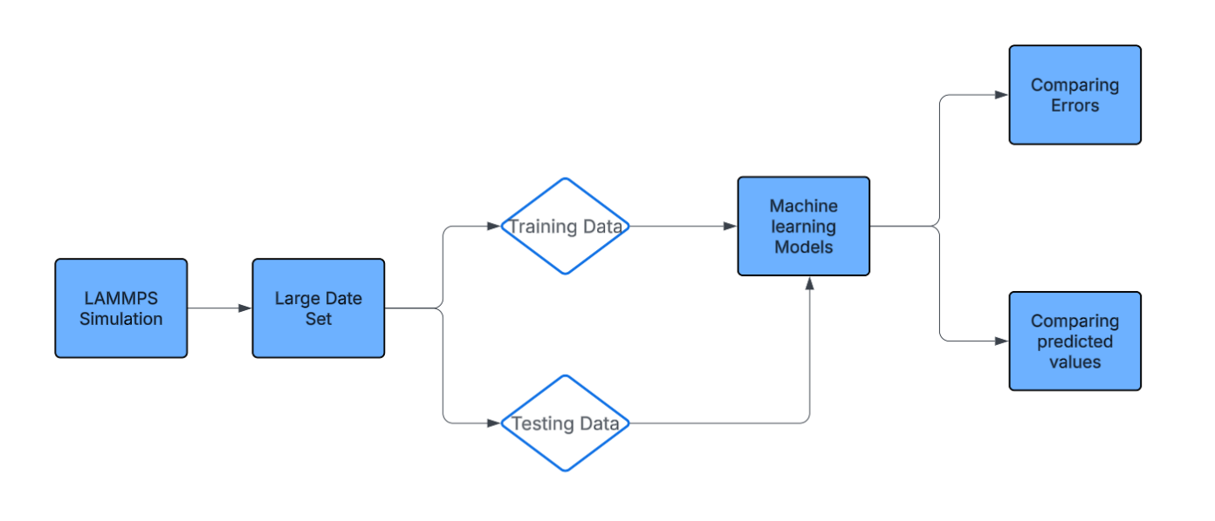
Machine Learning PipeLine
7
Notes:
Why you studying this materials

Slide 8
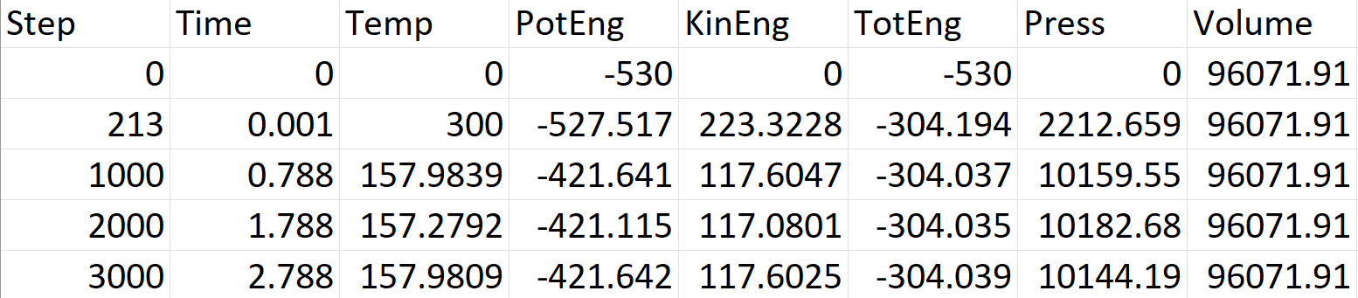
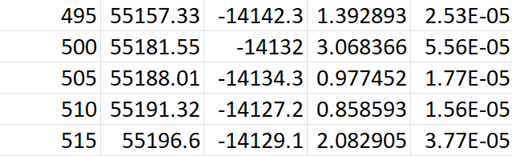
Data Obtained from MD:
Data after Alpha calculated :
8
Notes:
Why you studying this materials

Slide 9
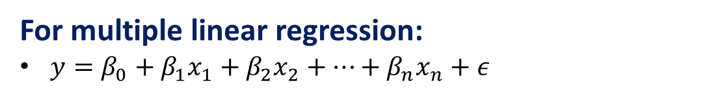
Linear Regression Model
Definition:
Linear Regression is a supervised machine learning algorithm used to model the relationship between one or more input features (independent variables) and a continuous output (dependent variable). It assumes that the output can be represented as a linear combination of the input variables.
For multiple linear regression:
$y=β_{0}+β_{1}x_{1}+β_{2}x_{2}+⋯+β_{n}x_{n}+ε$
MD → ML Workflow
In your case:
Inputs (X): Temperature, Potential Energy, Pressure, Volume
Output (y): Thermal Expansion Coefficient (α)
Linear regression finds how α changes linearly with thermodynamic variables — providing a fast and interpretable prediction model.
9

Slide 10
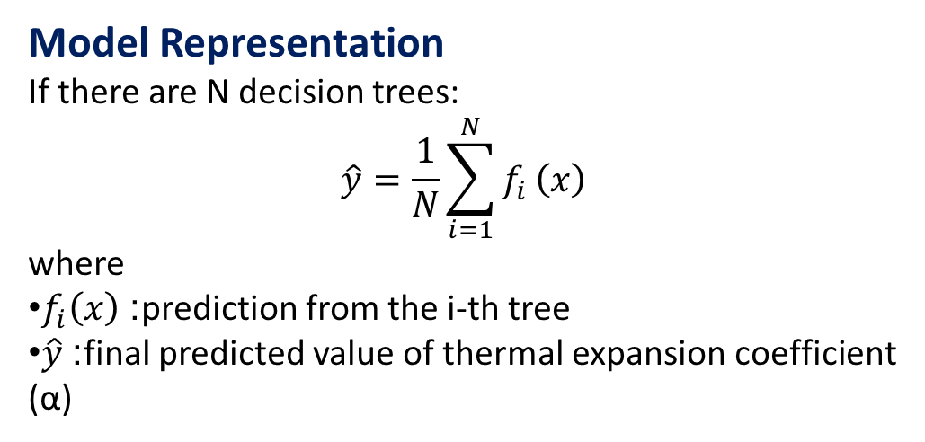
Random Forest Regressor
Random Forest Regressor Used to predict the thermal expansion coefficient (α) from MD-derived features such as Temperature, Pressure, Energy, and Volume.
Concept: Random Forest is an ensemble learning method that builds multiple Decision Trees and averages their predictions to improve accuracy and reduce overfitting.
Model Representation
If there are N decision trees:
$$\hat{y}=\frac{1}{N}\sum_{i=1}^{N}{f_{i}}\left(x\right)$$
where
$f_{i}\left(x\right)$: prediction from the i-th tree
$\hat{y}$: final predicted value of thermal expansion coefficient (α)
Each tree is trained on a random subset of data (bootstrap sampling) and a random subset of features, ensuring robustness and generalization.
10

Slide 11
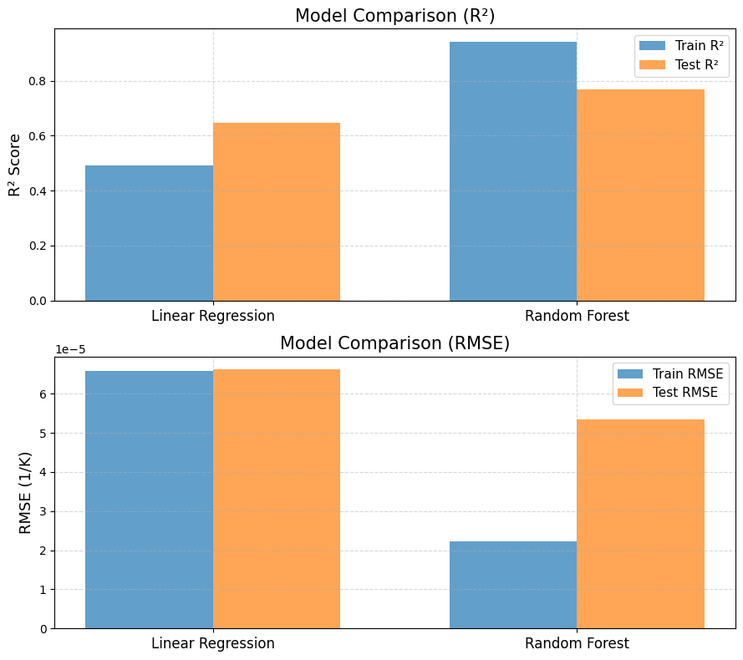
Model Comparison
11
Notes:
Why you studying this materials

Slide 12
Model Performance Comparison
Model | Train R² | Train RMSE | Test R² | Test RMSE
Linear Regression: | 0.4913 | 0.000066 | 0.6452 | 0.000066
Random Forest: | 0.9418 | 0.000022 | 0.7695 | 0.000053
1.Random Forest achieved higher accuracy than Linear Regression, indicating it captures non-linear relationships better.
2.The Train R² (0.94) and Test R² (0.77) of Random Forest show strong predictive performance with minimal overfitting.
3.Linear Regression performed moderately (Test R² = 0.65), suggesting a mostly linear but not perfect relationship
12

Slide 13
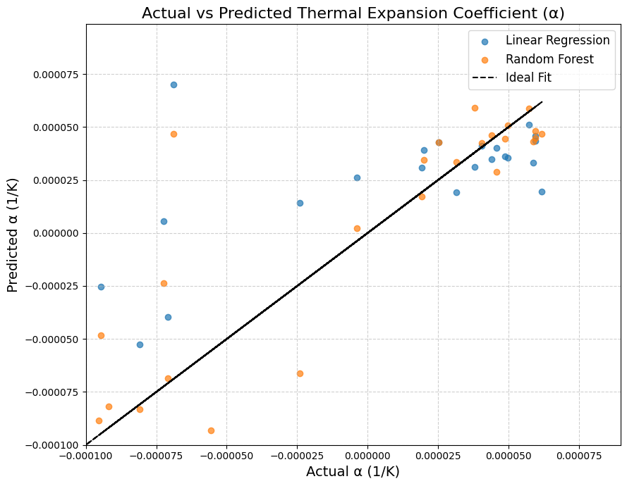
Inference: Actual vs Predicted α
The ideal line shows perfect prediction (Predicted = Actual).
Random Forest points lie closer to it, capturing non-linear atomic interactions better.
Linear Regression deviates more, missing complex relationships.
Data spread arises from MD fluctuations in vibration, energy, and volume.
Positive/negative α reflect local expansion and contraction due to anharmonic and lattice distortions.
Overall, Random Forest generalizes better with lower prediction error
13

Slide 14
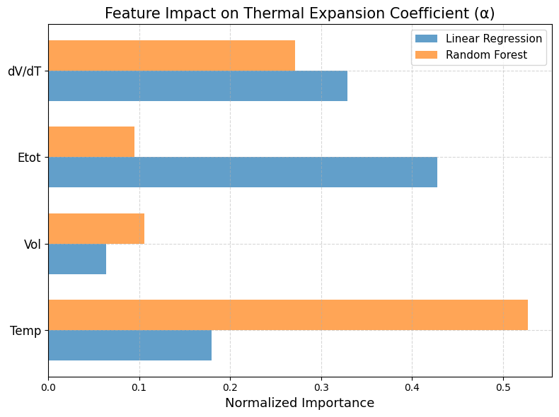

Slide 15
Feature Importance Analysis for Thermal Expansion Prediction
  Temperature (Temp) is the most dominant factor, showing the strongest influence on the thermal expansion coefficient (α).
  → Reflects the direct physical link between heat energy and lattice expansion.
dV/dT and Etot (Total Energy) contribute moderately, capturing the thermodynamic and structural response of Ti crystal to temperature changes.
Volume (Vol) shows minimal effect, indicating that absolute volume is less significant than its rate of change with temperature.
  Linear Regression emphasizes linear relationships — mainly Etot and dV/dT.
  Random Forest Regressor captures non-linear temperature dependencies, giving higher importance to Temp.
  Together, both models confirm that thermal expansion behavior is strongly temperature-dependent, with non-linear correlations better handled by Random Forest.
15
Notes:
Why you studying this materials

Slide 16
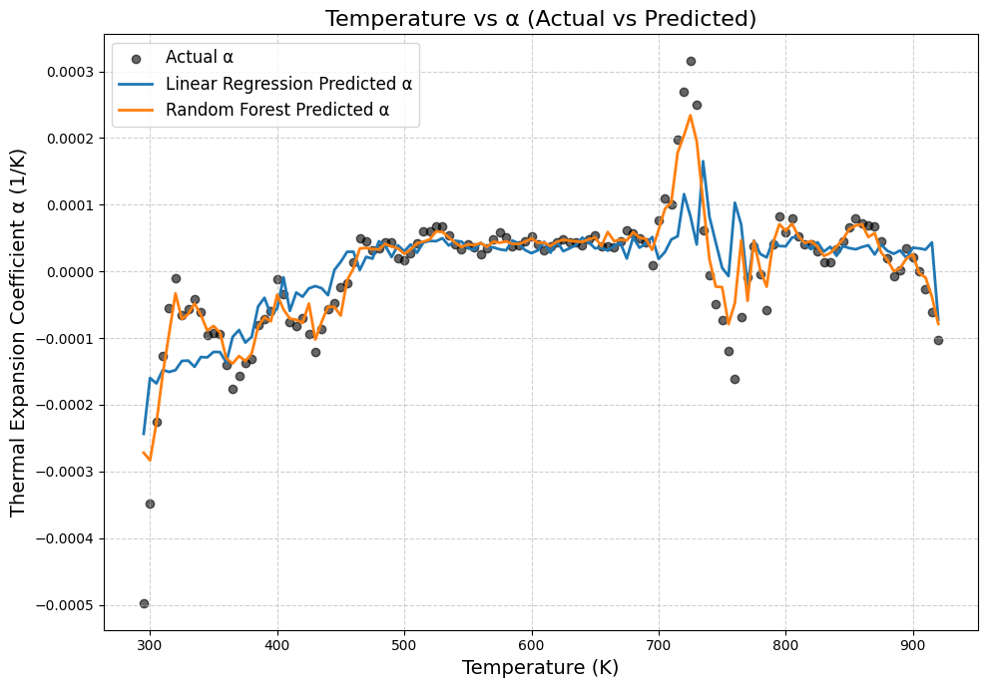
Results
16
Notes:
Why you studying this materials

Slide 17
Inferences from Temperature vs Thermal Expansion Coefficient (α)
Trend Observation:
α increases with temperature from 300 K → 700 K, indicating normal lattice expansion — atoms vibrate more and occupy larger average spacing.
Positive and Negative α:
  Positive α → material expands on heating (common metallic behavior).
  Negative α → slight contraction at lower temperatures due to anharmonic vibration imbalance or numerical fluctuations in MD data.
Fluctuations Around 750–850 K:
Sudden rise and dip correspond to anharmonic effects or possible α→β phase transition region of Ti, where lattice rearrangement temporarily alters expansion behavior.
Model Performance Insight:
  Linear Regression captures the overall trend.
  Random Forest better follows local variations due to its non-linear modeling strength.
  Both show reasonable agreement with actual MD-derived α values.
Physical Interpretation:
The near-zero average α values are realistic for Ti’s low thermal expansion nature, confirming that the MD simulation produced physically meaningful data.
17
Notes:
Why you studying this materials

Slide 18
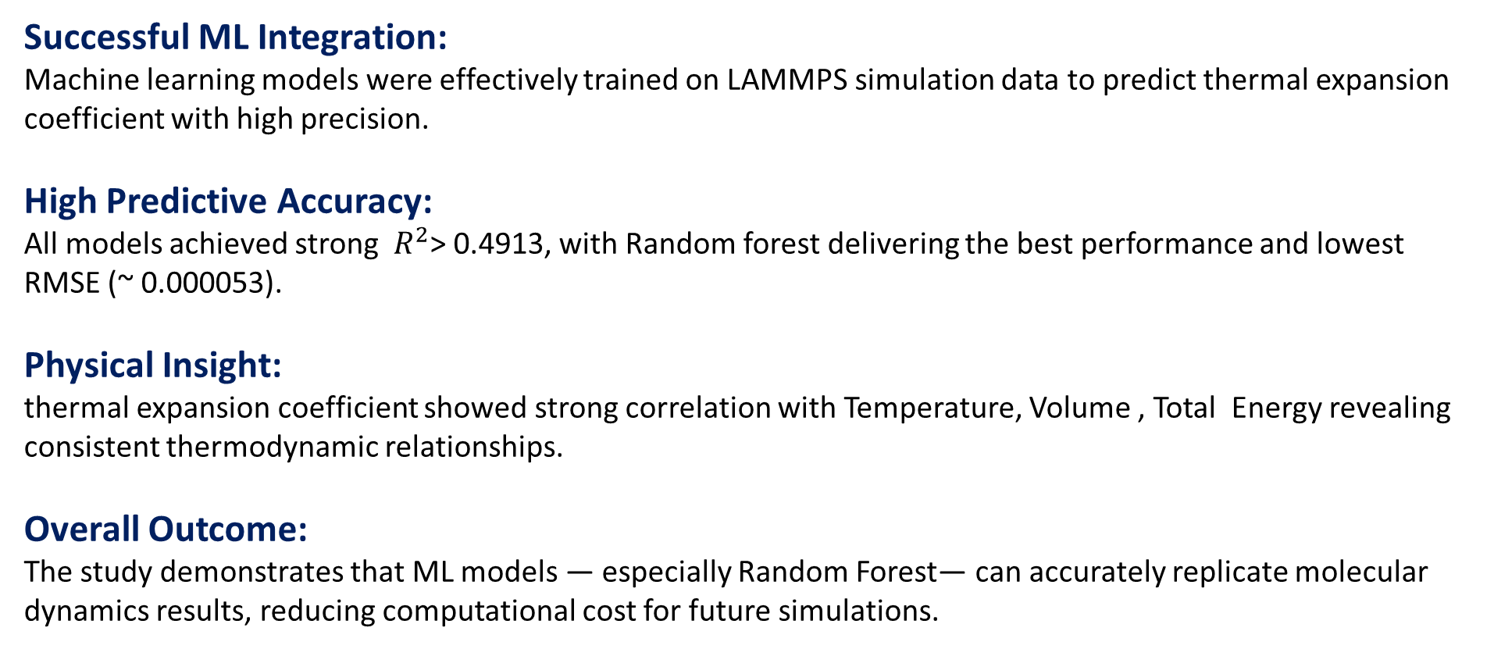
Conclusion:
Successful ML Integration:
Machine learning models were effectively trained on LAMMPS simulation data to predict thermal expansion coefficient with high precision.
High Predictive Accuracy:
All models achieved strong $R^{2}$> 0.4913, with Random forest delivering the best performance and lowest RMSE (~ 0.000053).
Physical Insight:
thermal expansion coefficient showed strong correlation with Temperature, Volume , Total Energy revealing consistent thermodynamic relationships.
Overall Outcome:
The study demonstrates that ML models — especially Random Forest— can accurately replicate molecular dynamics results, reducing computational cost for future simulations.
18
Notes:
Why you studying this materials

